Slide 1
Deep Learning
CA1
Ernest Ng P2222668 DAAA2B06

Slide 2
02
Recurrent Neural Networks

Slide 3
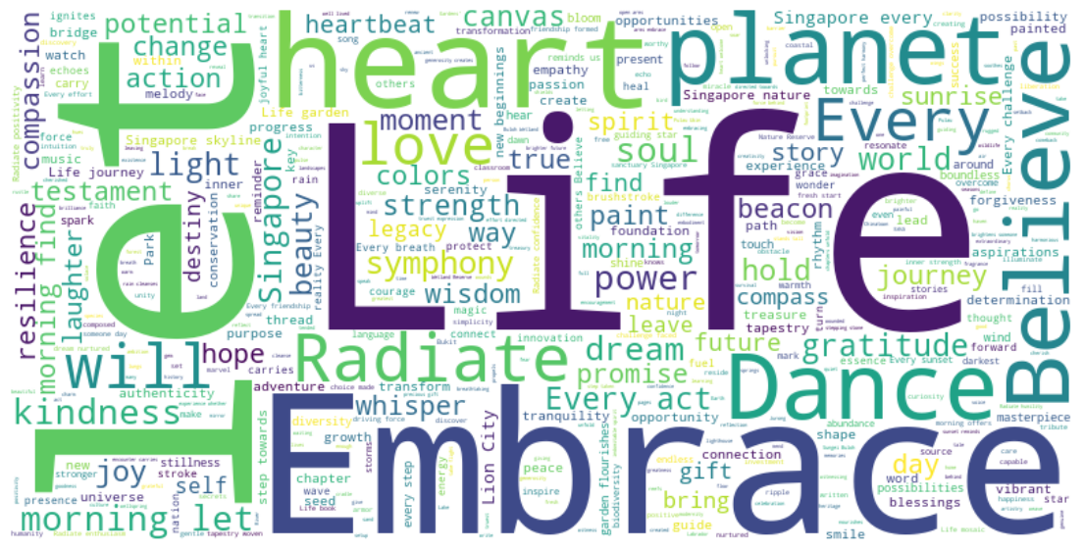
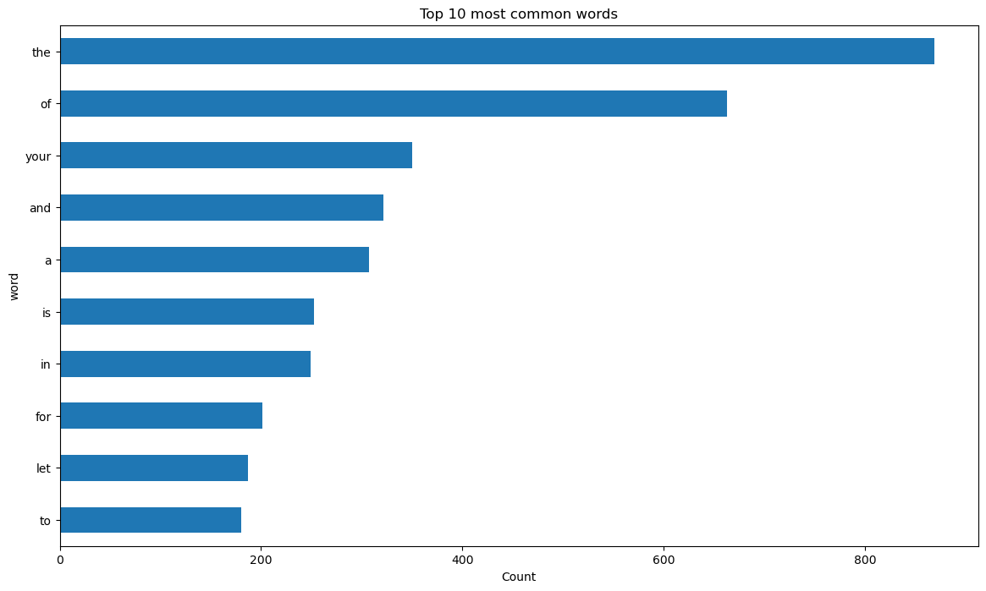
EDA
The words "Let," "Life," "Embrace," and "heart" show up a lot in our dataset.
Surprisingly, we don't see common words like "the" and "and." This happens because the wordcloud tool automatically removes very common words to focus on the more meaningful ones.
Now, the most common words are the usual ones like "the," "of," "your," and "and."
When we don't have the tool automatically removing them, we can see that all of the top 10 most common words in our dataset are these common words, often called stopwords.

Slide 4
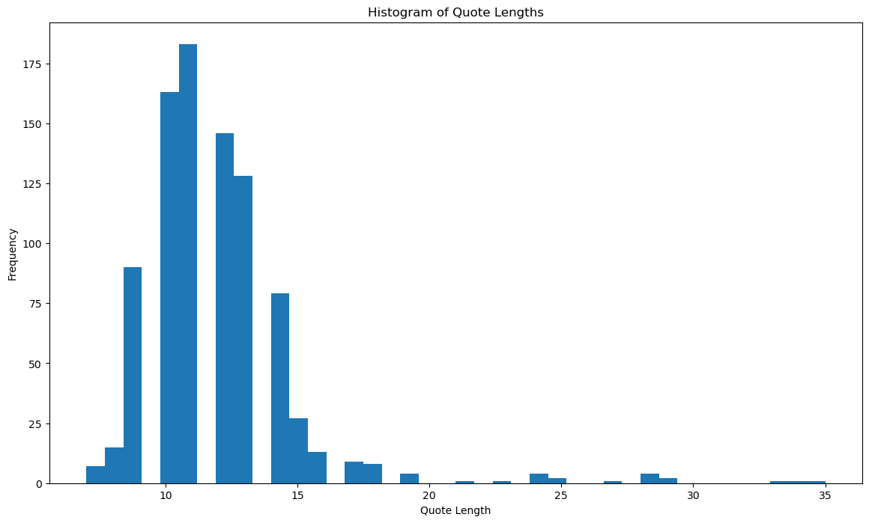
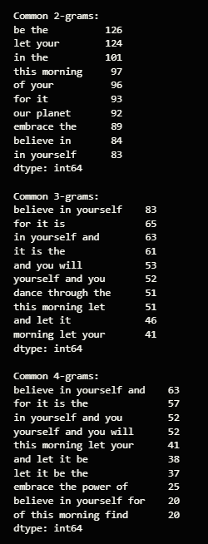
EDA
Most quotes are about 10-12 words long, with a few longer ones around 35 words. To make sure we capture most quotes well, we might need to pad sequences to a length slightly beyond our typical quote length.
Looking at our phrases, it seems like the sentiment in our text is mostly positive and motivational.
Common themes include self-belief and taking positive action.
Many word combinations express positive and motivational ideas, encouraging personal growth and confidence.

Slide 5
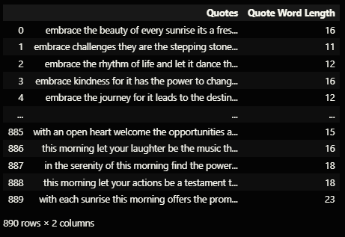
Data Preprocessing
{'ubin', 'hindhede', 'timah', 'semakau', 'merlion', 'skyline', 'soundtrack', 'kranji', 'tekong', 'hantu', 'buloh', 'wetland', 'pulau', 'changi', 'sentosa', 'coney', 'punggol', 'jawa', 'batok', 'bukit', 'brushstroke', 'asia', 'chek', 'clarke', 'jurong', 'singapore', 'peranakan', 'sungei', 'macritchie', 'biodiversity'}
Finding unusual words in the English Language
The unique words our code found are mostly related to Singapore, like "punggol," which is not an English word but Malay. This suggests that the text is special to Singapore, where we use words from various languages in our everyday conversations due to our diverse culture.

Slide 6
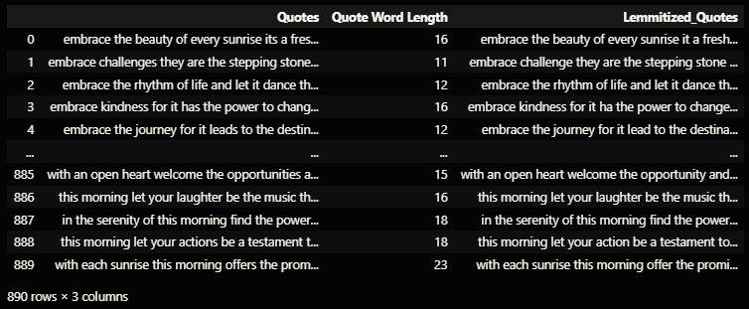
Data Preprocessing
Lemmitimizing our data
It refers to reducing our word to its base form. For example the lemma of “its” is “it”
We will test it on our model and see how it performs.

Slide 7
Building our Models
We will be trying 2 separate models for our text prediction
RNN (Base)
Long Short Term memory
We will be experimenting with the parameter of building a model, like the number of neurons and additional layers.

Slide 8
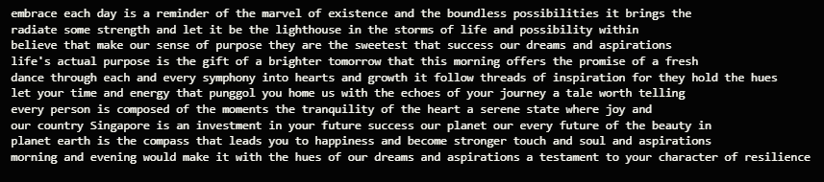
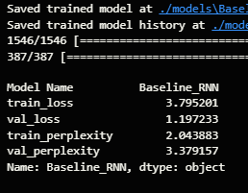
Baseline RNN
When quickly looking at the predicted text, it seems okay. However, when we read each line by itself, we notice that the sentences either don't make sense or are a mix of two separate sentences.
This connects to our high val_perplexity compared to train_perplexity. It indicates that our model isn't learning well to understand new data. This could mean our model is too focused on the training data (overfitting) or that the model's structure is too simple to grasp complex features, making it hard to understand new information.

Slide 9
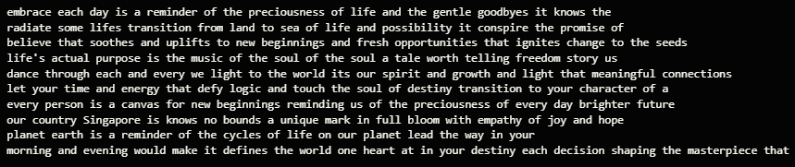
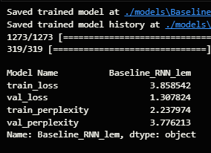
Baseline RNN - Lemmitimization
Using lemmatization didn't make our model do better on new data, as seen in the val perplexity.
This might be because: Making the vocabulary smaller with lemmatization might not always help. Sometimes, having more kinds of words can make the model understand things better.Lemmatization tries to make words standard but might make the language too simple, causing the model to miss some details.
The predicted text doesn't change much in meaning with lemmatization, showing that it hasn't really changed what our model generates.

Slide 10
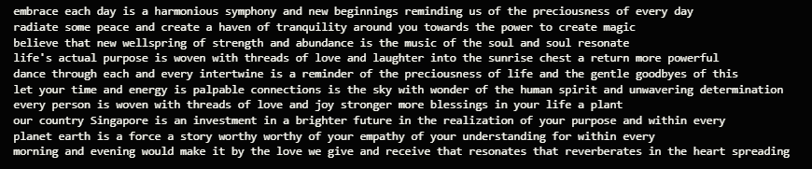
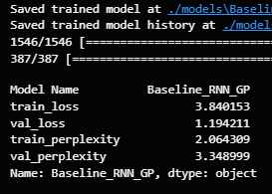
Baseline RNN - Gradient Clipping
The val perplexity is still higher than the train perplexity, but it's not as much as when we didn't use gradient clipping.
The sentences make sense for the first few words, but after the 6th-7th prediction, they start to not make sense.

Slide 11
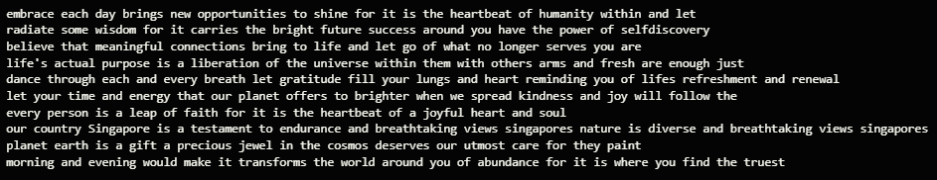
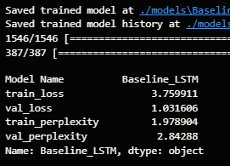
Base LSTM
The basic LSTM works better than our RNN models, showing lower perplexity scores.
LSTM handles the vanishing/exploding gradient problem well, making training twice as fast with a batch size that's half as big.
The predicted text makes more sense, with words forming better sequences compared to the RNN models.
This improvement is because LSTM can remember and forget information selectively, making it better at understanding long-term connections in the generated text.

Slide 12
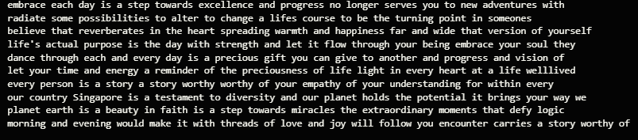
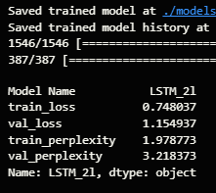
LSTM - 2 Layers
We will be adding an extra LSTM layer to increase our model’s complexity
With a more complex model, our LSTM doesn't do as well as the basic LSTM. The perplexity is a bit higher, meaning it doesn't understand the language or predict as accurately.
This suggests that having a more complex model doesn't always make it better.
The sentences don't flow as smoothly, and they're not as easy to understand as the ones from the basic LSTM model.

Slide 13
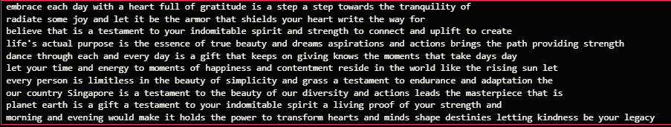
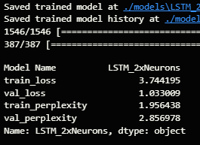
LSTM - 2X amount of neurons
We get similar results as compared to the base LSTM
The sentences are somewhat coherent and does convey some meaningful messages.

Slide 14
Model Improvement
We will be trying 2 strategies to improve our LSTM models
Adding a learning rate scheduler
Bi-directional LSTMs
Why?
Learning Rate Scheduler:
We use a learning rate scheduler because changing the learning rate during training can greatly affect how well the model learns. When the model is getting close to finding the best values, we want it to take smaller steps to avoid overshooting the optimal solution.
Bidirectional LSTM:
Bidirectional LSTMs capture patterns in both forward and backward directions in sequential data. Including this bidirectional processing helps our model understand context better, using information from both earlier and later time steps.

Slide 15
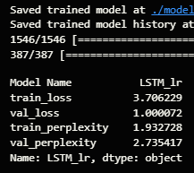
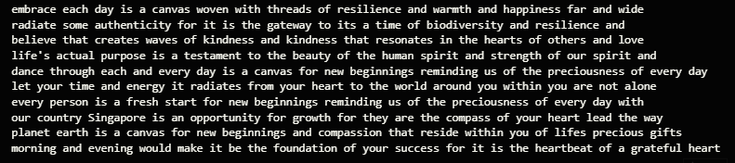
Learning Rate Scheduler
The introduction of a learning rate schedule has led to a decrease in perplexity, indicating improved model convergence and better generalization to new data.
The sentences now exhibit greater coherence and meaning. The implementation of a learning rate schedule seems to have assisted the model in finding a more effective balance while adjusting weights during training.

Slide 16
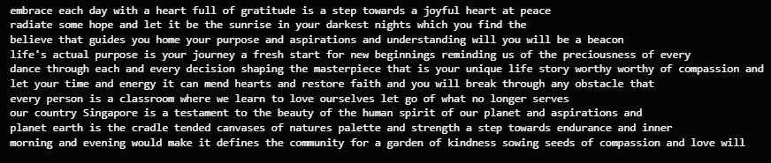
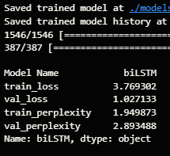
Bi Directional LSTMs
Adding Bidirectional LSTMs has made our sentences less coherent compared to when we didn't include them.
The perplexity stays the same.
This suggests that the bidirectional information might not be helping our model's understanding in a positive way.

Slide 17
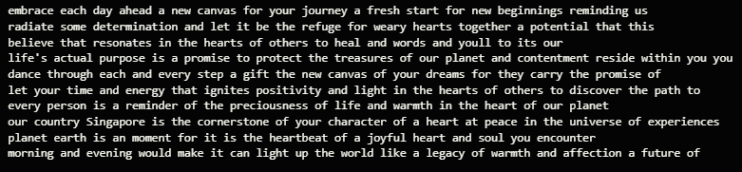
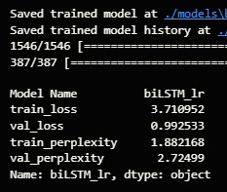
Learning Rate Sceduler + Bi Directional LSTM
The introduction of a learning rate scheduler improves our perplexity.
However, the sentences are still incoherent compared to when using Bidirectional LSTMs.
This suggests that our model might not benefit from understanding both past and future contexts.
In the previous model (biLSTM), using bidirectional LSTMs led to less coherent sentences. Adjusting the learning rate in the current model (biLSTM_lr) seems to have somewhat improved sentence coherence.

Slide 18
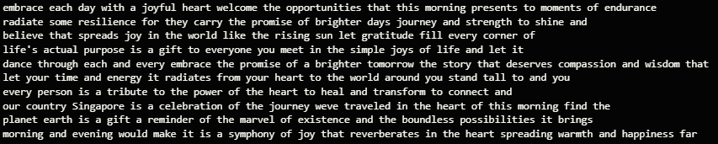
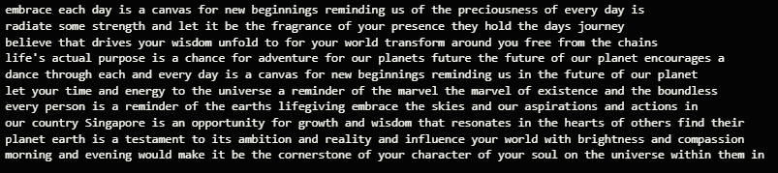
Model Evaluation
After trying out different setups, we choose the LSTM model with double the number of neurons, which helps it understand language better. We also added a learning rate scheduler to make the training process smoother and more efficient.

Slide 19
Summary
In summary, I experimented with various architectures, including basic RNNs, LSTMs, and Bidirectional LSTMs. I delved into the impact of factors like layer depth and neuron count, aiming to optimize model performance. Implementing a learning rate scheduler proved effective in improving model convergence. While the introduction of Bidirectional LSTMs brought about some coherence challenges in generated sentences.

Slide 20
Thanks
Do you have any questions?
your email@freepik.com
+91 620 421 838 yourcompany.com
Please keep this slide for attribution

